Slide 1
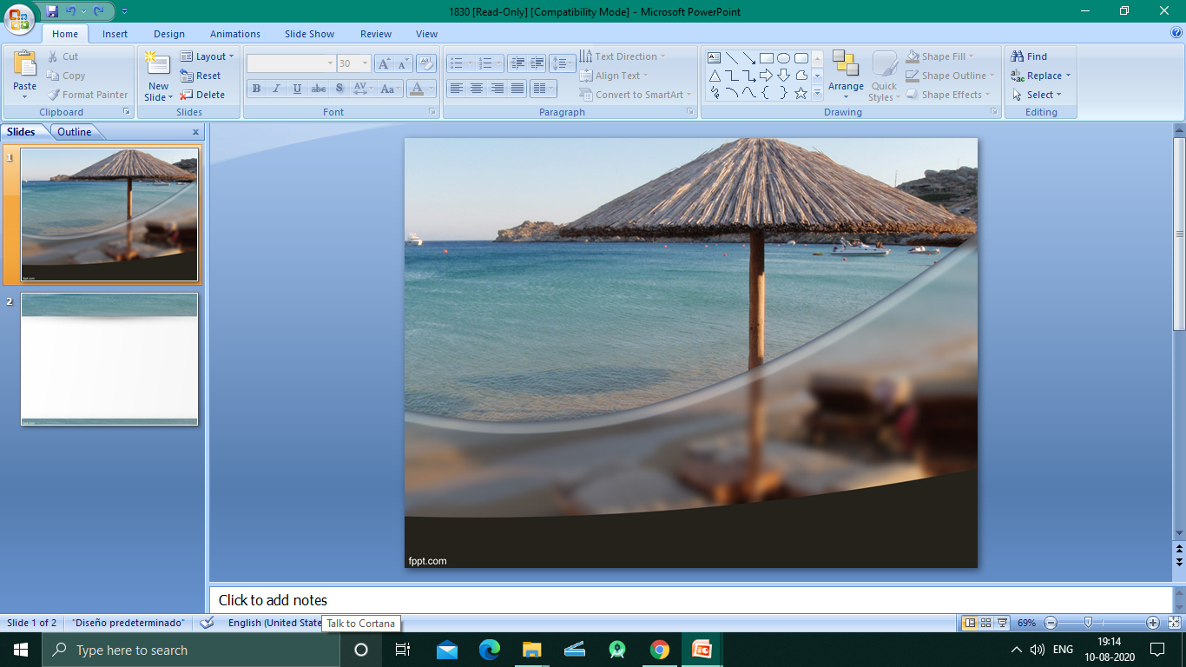
TOURS & TRAVEL MANAGEMENT SYSTEM
Notes:
© Copyright PresentationGO.com – The free PowerPoint and Google Slides template library

Slide 2
Introduction
The main purpose of this desktop application is to facilitate the offline customer because customers cannot spend their precious time in markets trying to find out the best deal.

Slide 3

Project Objective
It is basically a desktop application.
It is designed for one particular administrator.
Through this system admin can manage the customer & also can keep the information of hotel availability.
From this system Admin can view daily, weekly and monthly report.
This system is develop for admin who can add, delete,
edit and view the data related to places, travels,
bookings from this system.

Slide 4
Existing Features
This “Tours & Travel Management System” has been designed to computerize the following functions that are performed by the system:
Customer details function
Room details function
Opening a new room
Sign up of new customer
Booking details function
Opening a new hotel
Hotel details function
Check in function
Room assigning to customer’s need
Room occupancy details functions

Slide 5
Business concept
Here the details of hotels in various location will be stored.
It is a desktop application so data will be entered from the user side.
The minimum requirement to access the application is a normal desktop with JDK installation. The memory requirement is very minimum.
The customers can book hotel in advance.
If a customer is already contact with us then the details of him/her is already in our database.
The data are well organised , well maintained and easy to access.

Slide 6
Software Requirements
OS: Windows 7 Or Later, Linux, Mac OS
Software: JDK 11 or Later
Hardware Requirements
Processor: Intel Pentium II or More
RAM:256MB
Hard Disk: 20GB or More

Slide 7
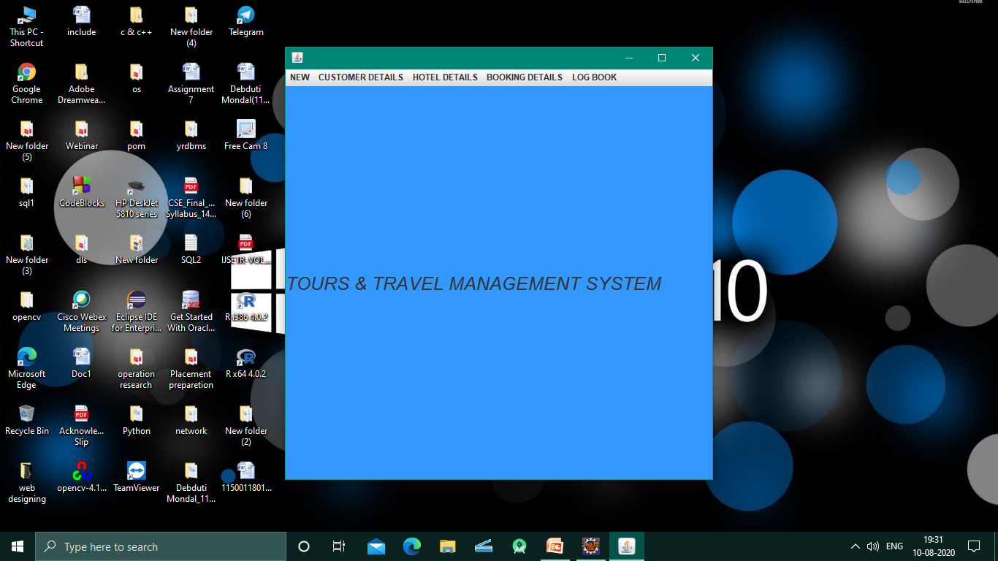
PROCESS:
Notes:
© Copyright PresentationGO.com – The free PowerPoint and Google Slides template library

Slide 8
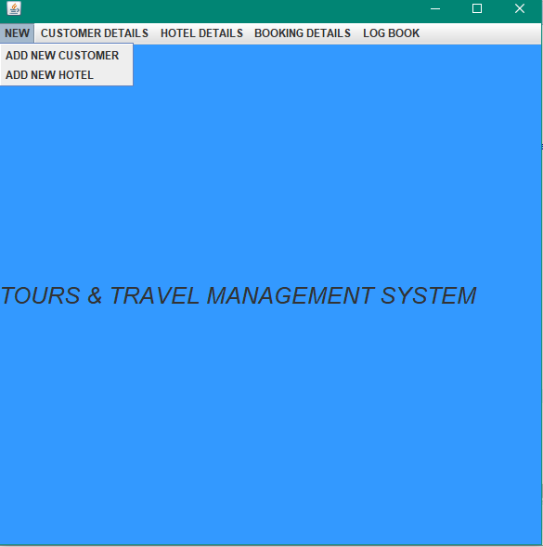
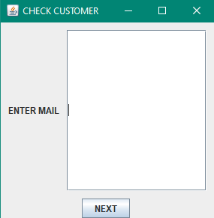
Notes:
© Copyright PresentationGO.com – The free PowerPoint and Google Slides template library

Slide 9
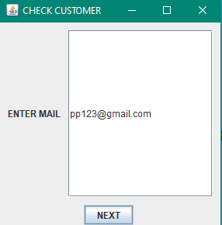
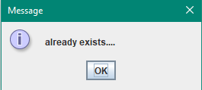

Slide 10
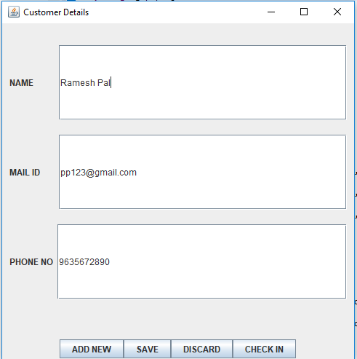

Slide 11
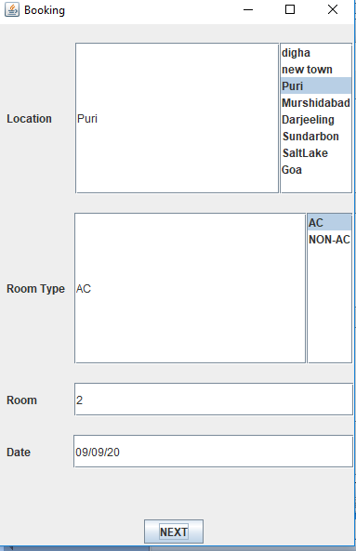
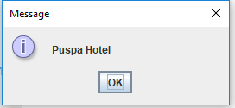

Slide 12
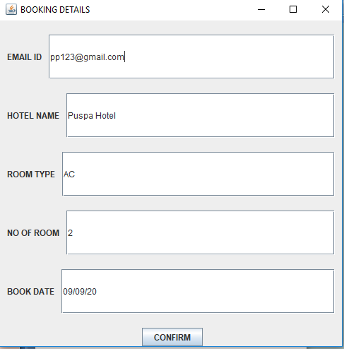
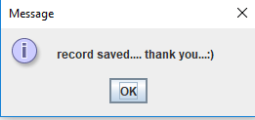

Slide 13
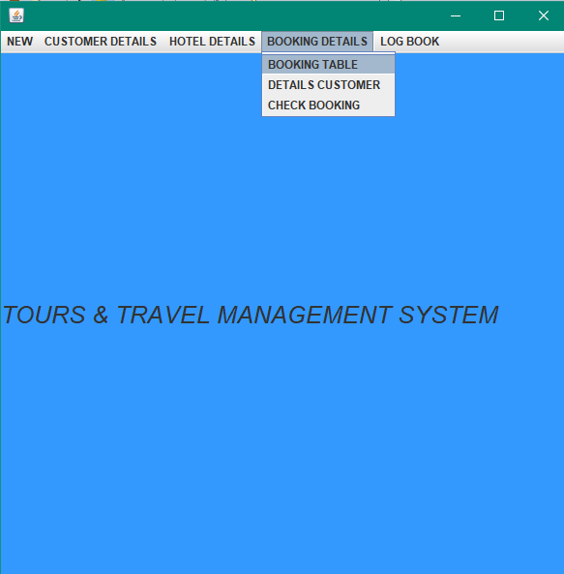
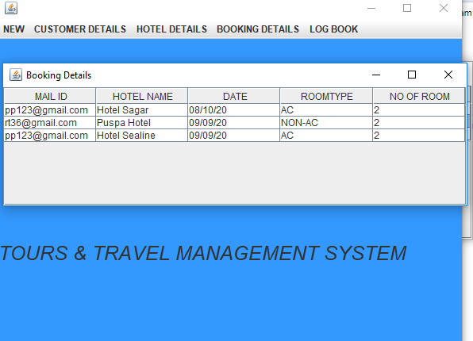

Slide 14
Notes:
© Copyright PresentationGO.com – The free PowerPoint and Google Slides template library

Slide 15
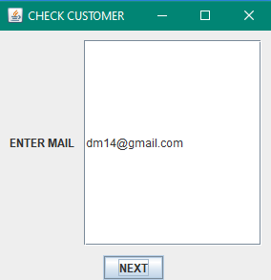
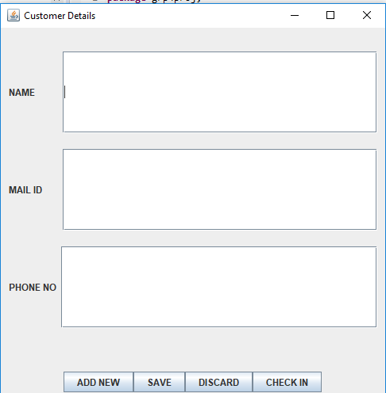
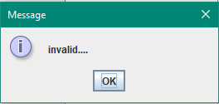

Slide 16
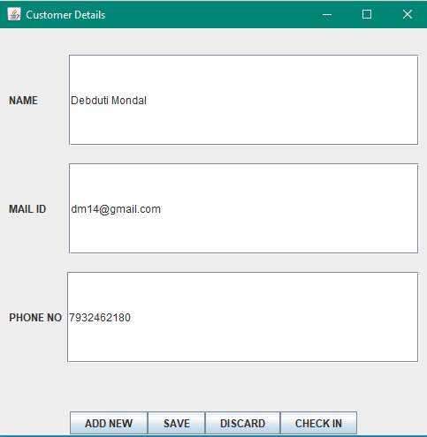
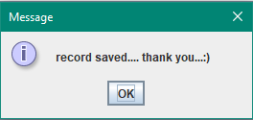

Slide 17
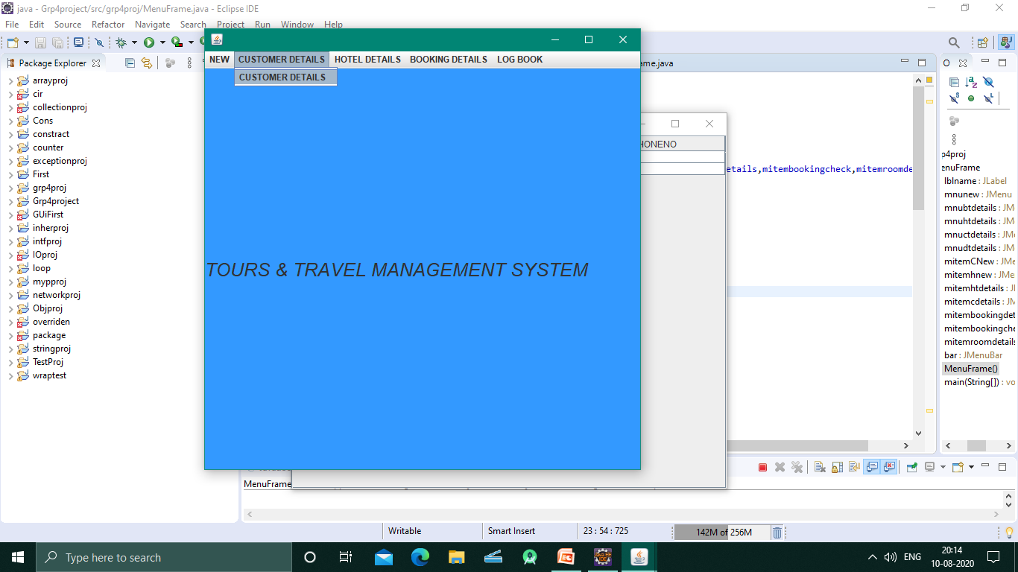
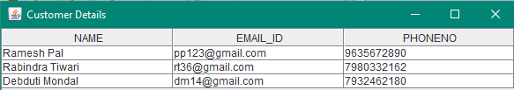

Slide 18
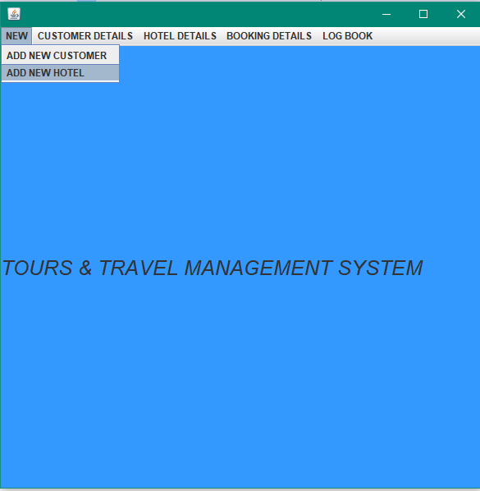
Notes:
© Copyright PresentationGO.com – The free PowerPoint and Google Slides template library

Slide 19
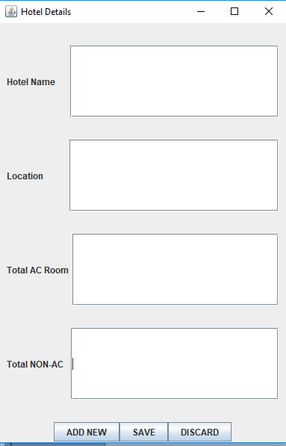
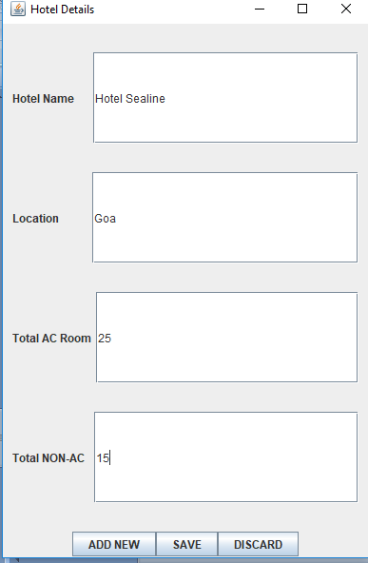
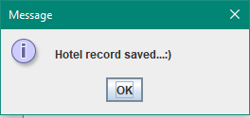

Slide 20
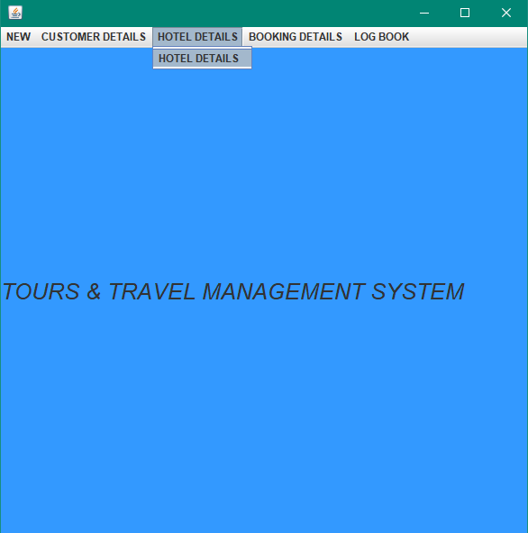
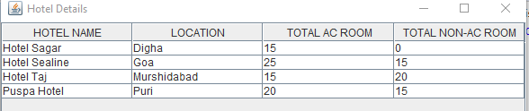

Slide 21
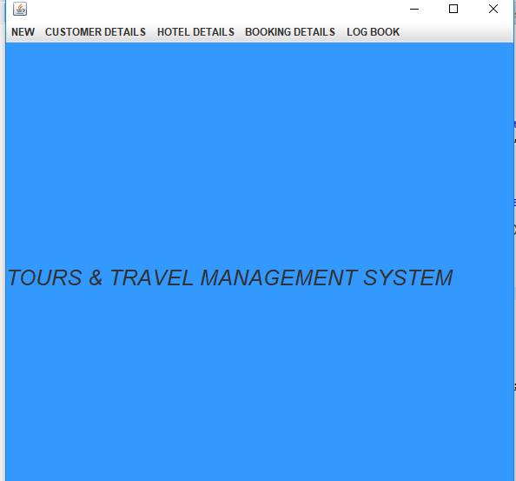
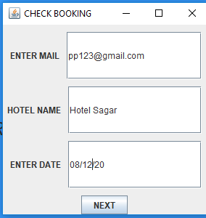
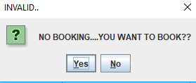
Notes:
© Copyright PresentationGO.com – The free PowerPoint and Google Slides template library

Slide 22
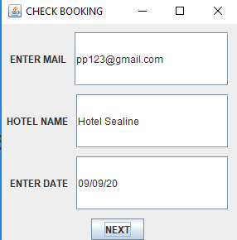
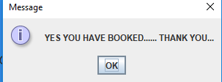

Slide 23
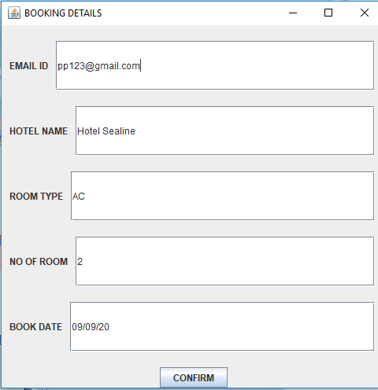
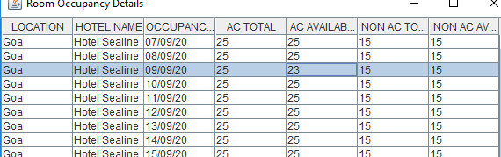

Slide 24
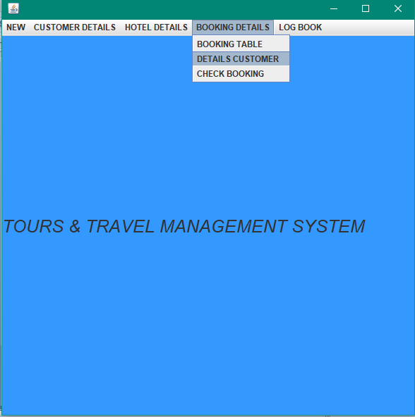
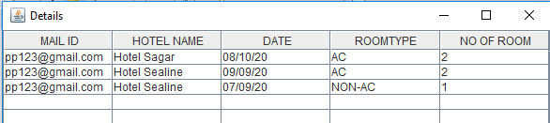

Slide 25
Future Implementation:
After booking a confirmation mail should be included to the customer.
Keep a route map.
Further more hotels can be added in various location.
The booking process can be developed in case of more than one day booking.

Slide 26

Notes:
© Copyright PresentationGO.com – The free PowerPoint and Google Slides template library

